Slide 1

Human Facial Expression Modification
Difan Chen & Zhou Wang
12/04/2014
Notes:
Good Afternoon, everyone. My name is Difan Chen, and my teammate is Zhou Wang. What we did in this project is to modify human facial expression automatically.

Slide 2
Outline
Introduction
Method
Demonstration
Notes:
There are three parts. First, I will introduce the background and significance of our project. Then I will talk about the techniques we used. In the end, I will show you a demo to see how to modify facial expressions automatically.

Slide 3
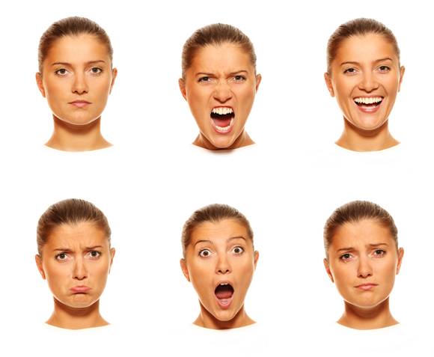
Introduction
Background
Significance
Notes:
First, I want to say facial expression is a very interesting topic. Facial Expressions are the window of our emotions. It contains too much information that we want to deliver to others.

Slide 4
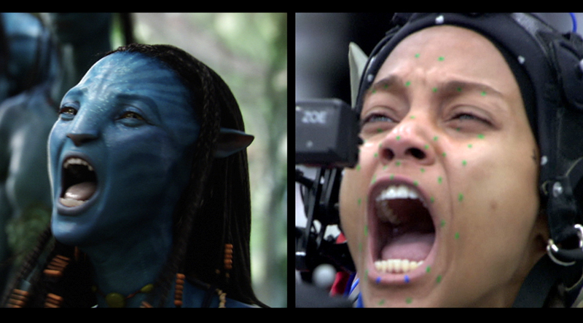
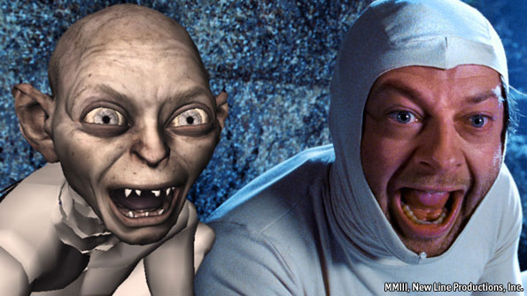
Introduction
Notes:
In movie industry, people capture actors’ facial expression to create avatar.

Slide 5
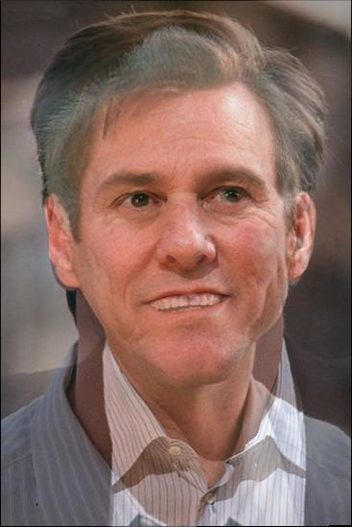
Method
Image Morphing
With Reference Image Without Reference Image
Notes:
In our project, there are two ways to modify facial expressions. One is with reference image, the other is without reference image. Let’s move to these two methods one by one.

Slide 6
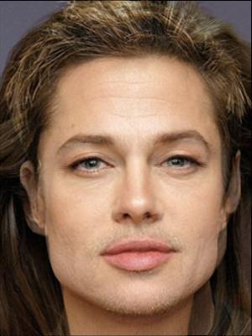
With Reference Image
Notes:
First, mark down all corresponding feature points for two images. Then create the intermediate points from each point pair. And triangulation and use inverse warping to fill the pixel within each triangle. Last, add two images to form the result image.

Slide 7
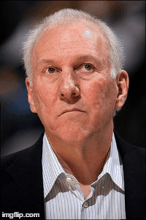
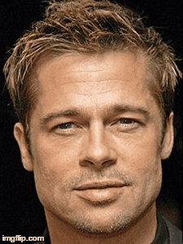
With Reference Image
Procedures:
Get features points for both images
Create intermediate points based on feature points pair of step 1
Inverse warping to fill pixels in each triangle of the intermediate image
Do inverse warping for both images,
Sum up both images according to some percentage
Notes:
Two examples

Slide 8

Without Reference Image
Notes:
The second method is without reference image. For my application, I provided two ways to load an image. We can read a local image or from the web camera. Then I utilized Face detection API provided a company called Rekognition. This API can tell me the position of feature points accurately. Then I do image morphing. The biggest difference with the first method is that I don’t need to create some intermediate points. However, I just change the position of some feature points slightly.

Slide 9
Without Reference Image
Change position of features slightly
Smile
Notes:
Concretely, I just move the feature points of mouth by several pixels to make the mouth larger.

Slide 10
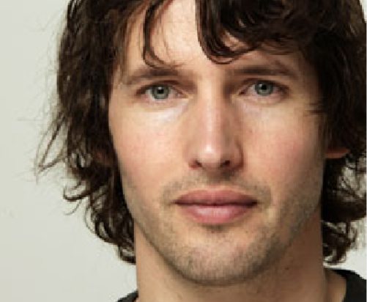
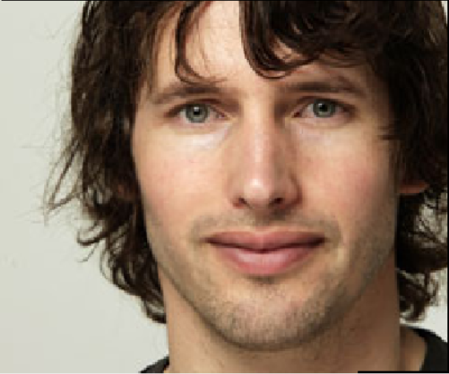

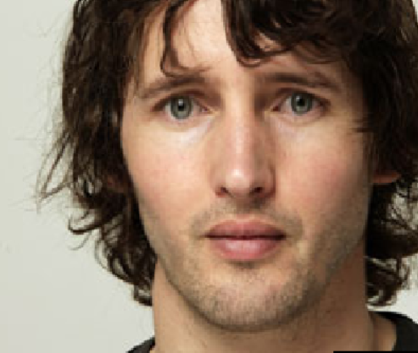
Demo
MATLAB GUI
Notes:
I created a MATLAB GUI to show you how to do that

Slide 11
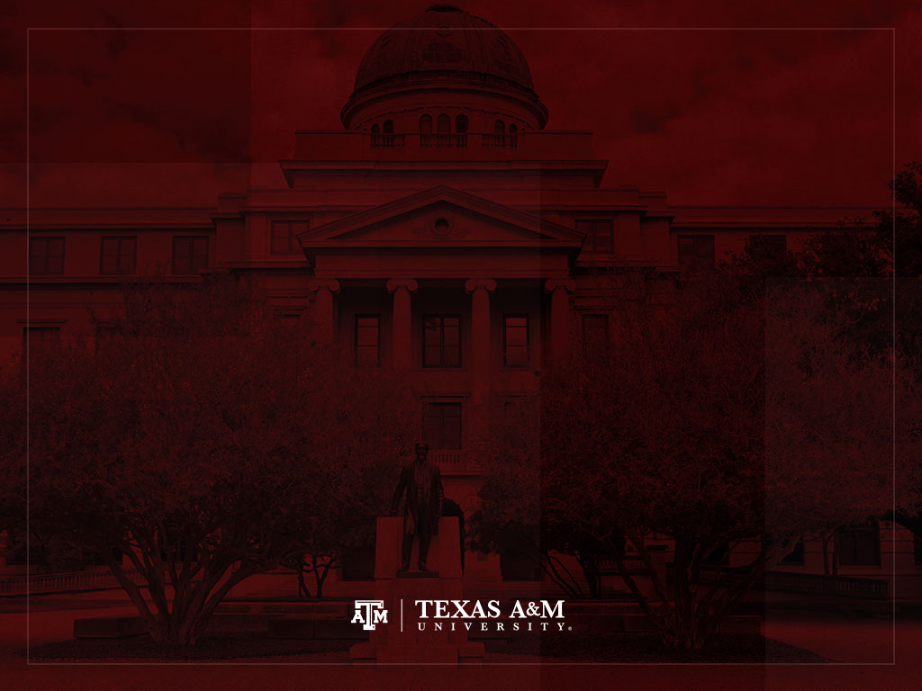
Thank you!
Any Questions?

